Slide 1
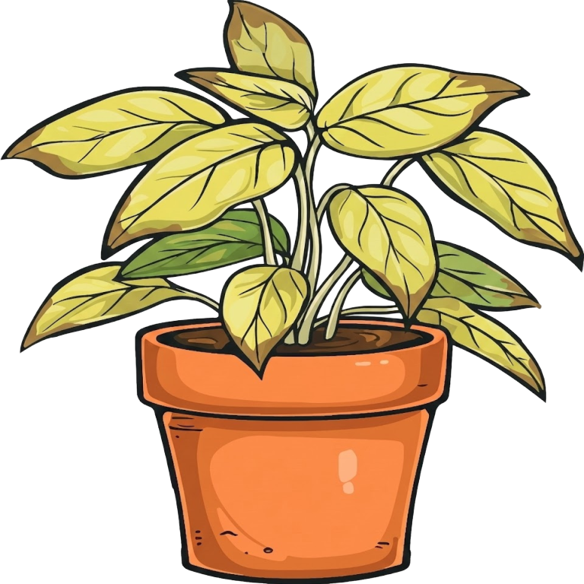
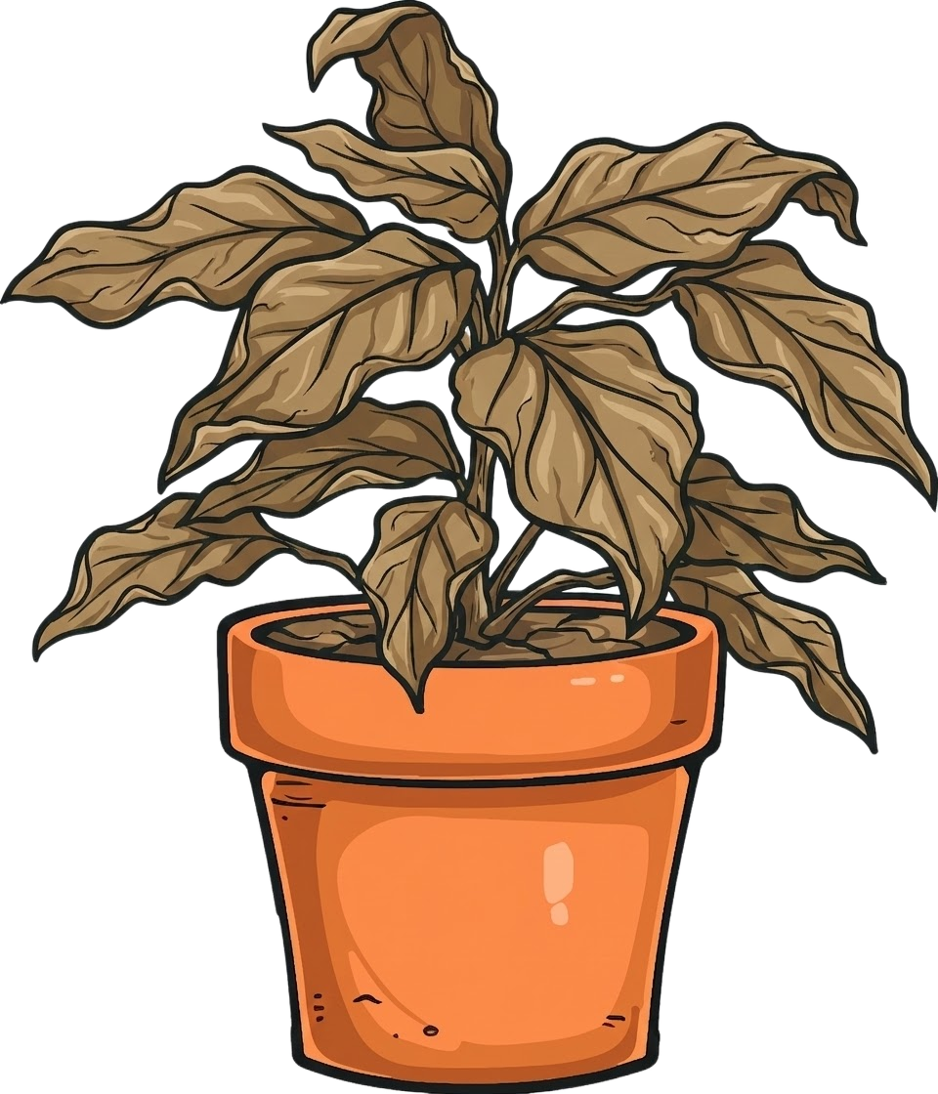

McCay's Houseplant Recommender
Reality
Expectation

Slide 2
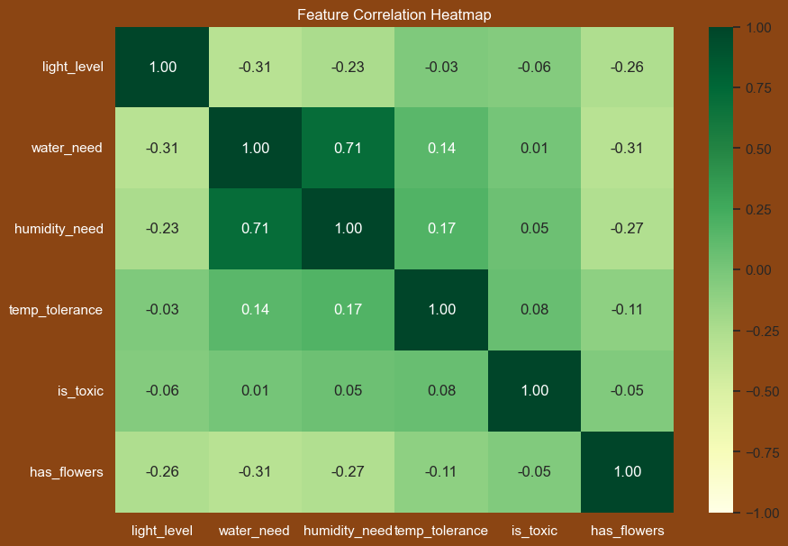
Data Source
"Growing Indoor Plants with Success"
Author: Dr. Bodie V. Pennisi
Institution: University of Georgia Extension
Dataset Size: 250 Distinct Species

Slide 3
User Input
Beginner
Plant Parent
Questionnaire
Item Match
Heuristic Model
KNN Model
Top 3 Recommendations

Slide 4
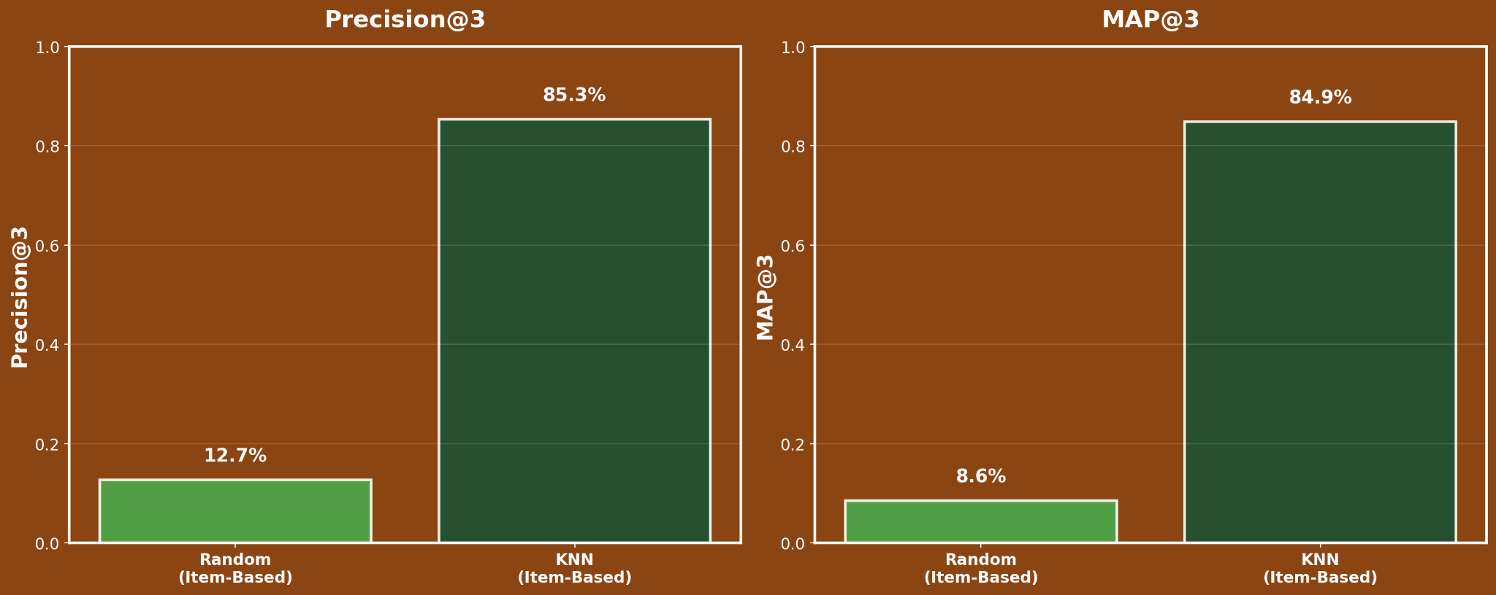

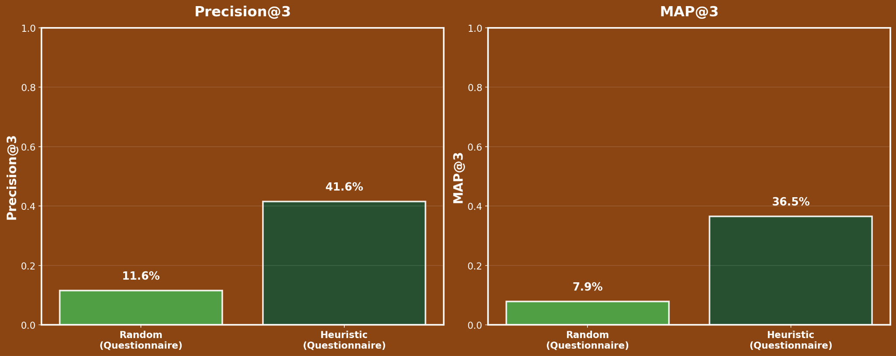

Trade Offs
Item Match
“I know what I like”
Questionnaire
“Beginner”

Slide 5

Next Steps
Build a pretty interface
Test with real people
Go out there and keep some plants alive! :D

Slide 6
Sources
Plant Photos: https://www.vecteezy.com/members/timplaru-olivia23651162
Original Dataset: https://zenodo.org/records/6984514
Publication: https://fieldreport.caes.uga.edu/publications/B1318/growing-indoor-plants-with-success/

